Slide 1
Analyzing Hospital Readmission Rates for Diabetes
Minivia Fernandes

Slide 2
Dataset
Represents 10 years (1999-2008) of clinical care at 130 US hospitals and integrated delivery networks
Includes over 50 features representing patient and hospital outcomes
Extracted information of encounters meeting the following criteria:
It is an inpatient encounter (a hospital admission)
It is a diabetic encounter, that is, one during which any kind of diabetes was entered to the system as a diagnosis
The length of stay was at least 1 day and at most 14 days
Laboratory tests were performed during the encounter
Medications were administered during the encounter

Slide 3
Outcome of Interest: Hospital Readmission within 30 Days
Readmission rates are used as an outcome measure in health services research and as a quality benchmark for health systems
Good indicator that something has been missed in the patient’s first hospital admission
Large driver of cost within the healthcare system
Notes:
Outcome variables
Readmission rates as an outcome variable
Readmission refers to being hospitalized again after being discharged and is significant for two reasons: quality and cost of health care [1]. In other words, readmission reflects relatively low quality [2] and also has negative social impacts [3-5].

Slide 4
Analysis Approach
Download dataset from UCI Machine Learning Repository
Load data into MySQL
Use SQL CASE WHEN queries to code and map codes (ie: admission_type_id)
Cross tabulate data by race, gender, and readmission type using SQL queries
Generate plots and statistics in Python
Notes:
Outcome variables
Readmission rates as an outcome variable
Readmission refers to being hospitalized again after being discharged and is significant for two reasons: quality and cost of health care [1]. In other words, readmission reflects relatively low quality [2] and also has negative social impacts [3-5].

Slide 5
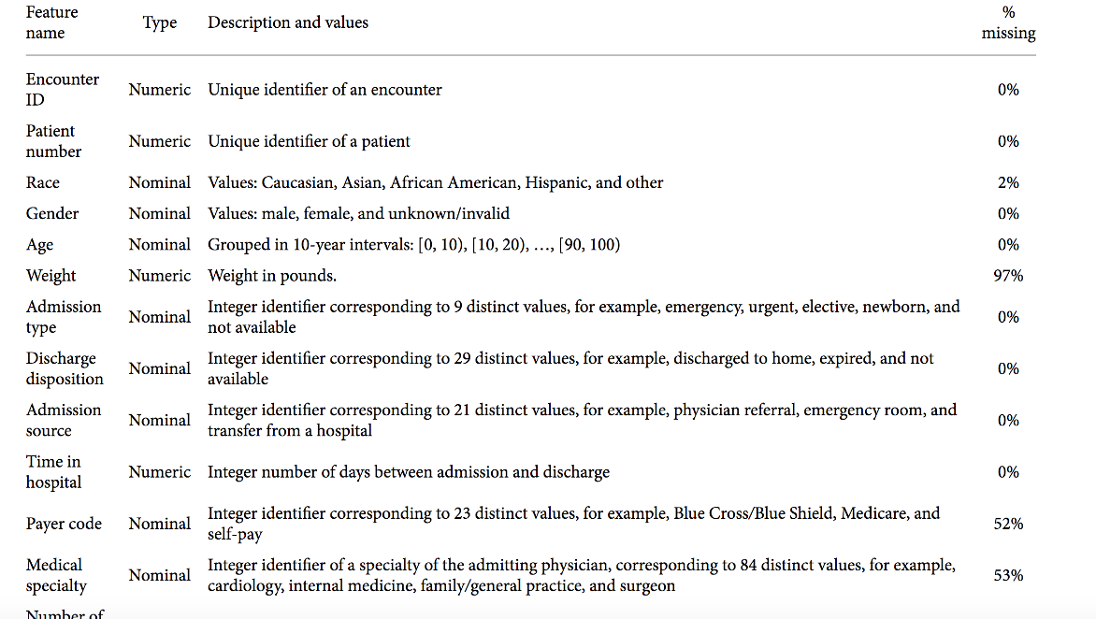
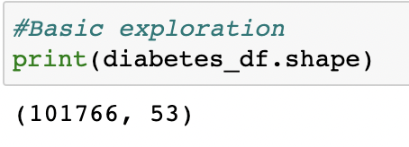
Dataset Exploration
Dataset has 101766 entries and 53 attributes

Slide 6
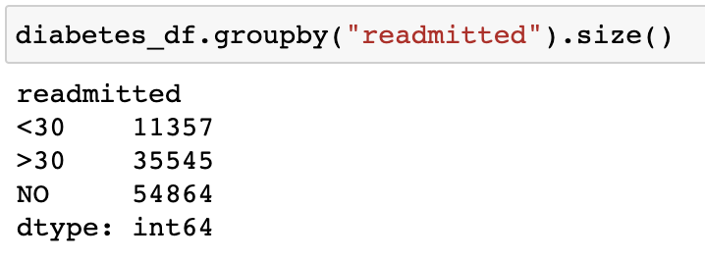
Dataset Exploration
About 11,357 patients were readmitted within 30 days
About 35,545 patients were readmitted after 30 days
Majority of patients were not readmitted

Slide 7
Hypothesis
Data measurements of a patient such as age, weight, number of medications, number of procedures should affect the readmission rate.
The hypothesis is that patients with higher age, larger weight, more procedures, and no/less medication are more likely to get readmitted sooner than patients who are of younger age or normal weight.
It is also believed that the glucose serum levels that are not normal and any change in medications should affect the hospital readmission rate.

Slide 8
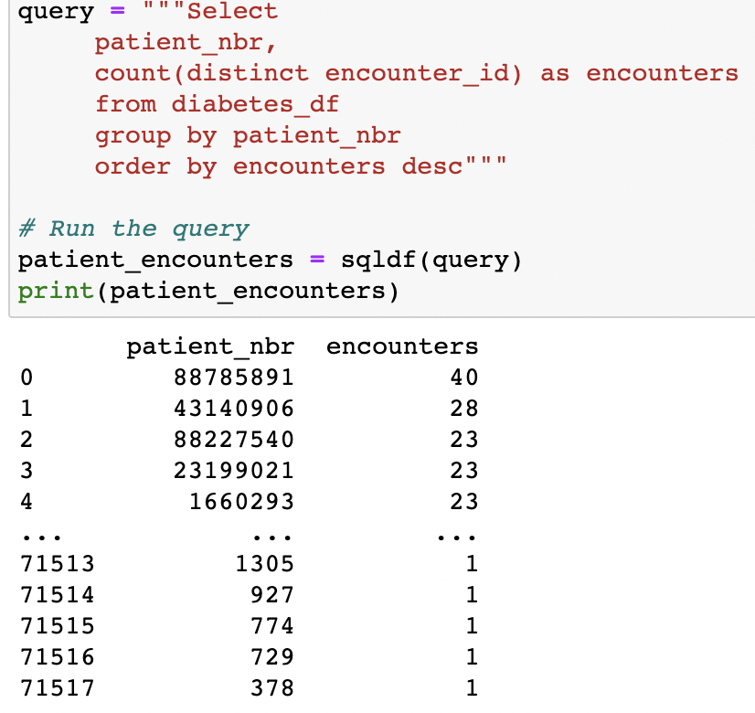
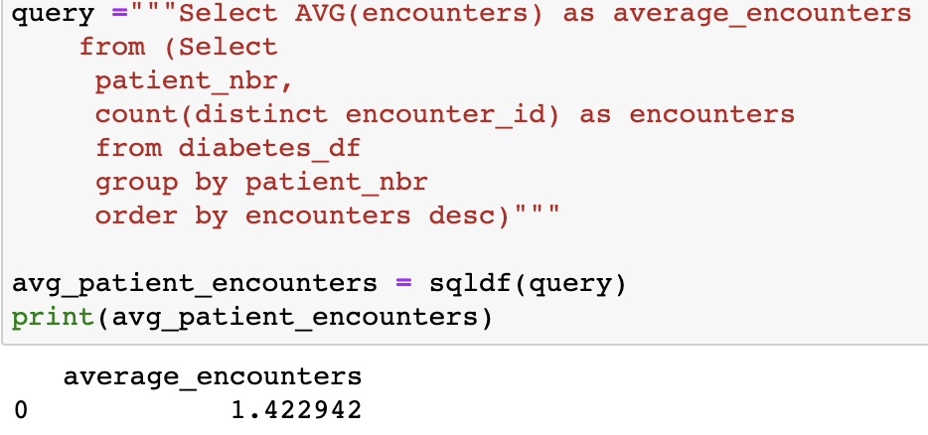
Exploratory Data Analysis (EDA):
How many encounters by patient?
The average number of encounters by patient was approximately 1.42 encounters by patient
There were some outliers (ie: 1 patient having 40 encounters)

Slide 9
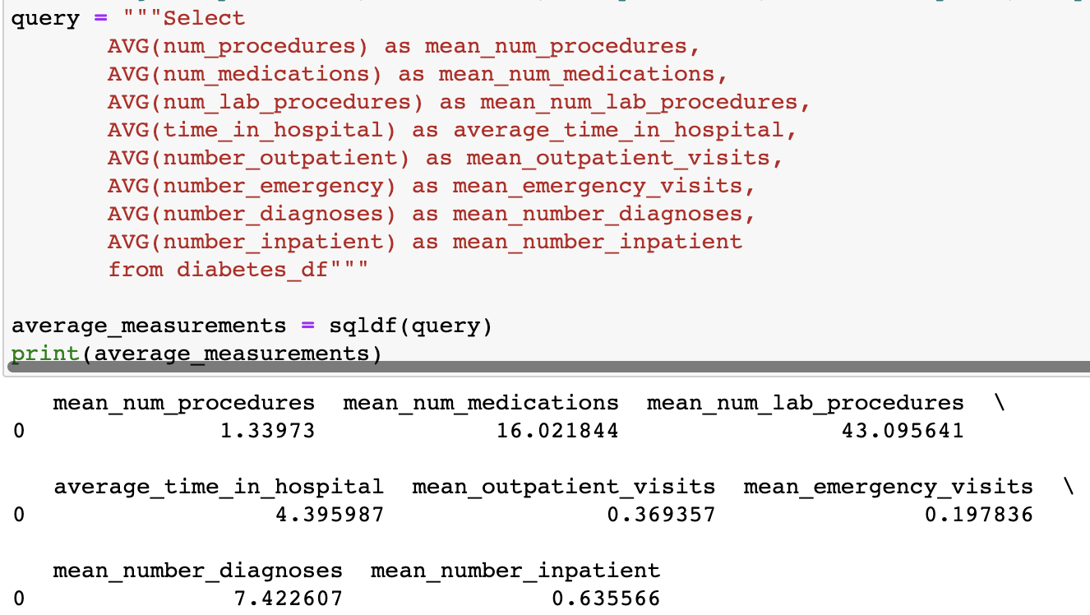
EDA: Mean Averages
Average number of procedures = 1.34 procedures
Average number of medications = 16.02 medications
Average number of lab procedures = 43.10 lab procedures
Average time in hospital = 4.40 days
Average number of outpatient visits = .37 visits
Average number of emergency visits = .20 visits
Average number of diagnoses = 7.42 diagnoses
Average number of inpatient visits = .64 visits

Slide 10
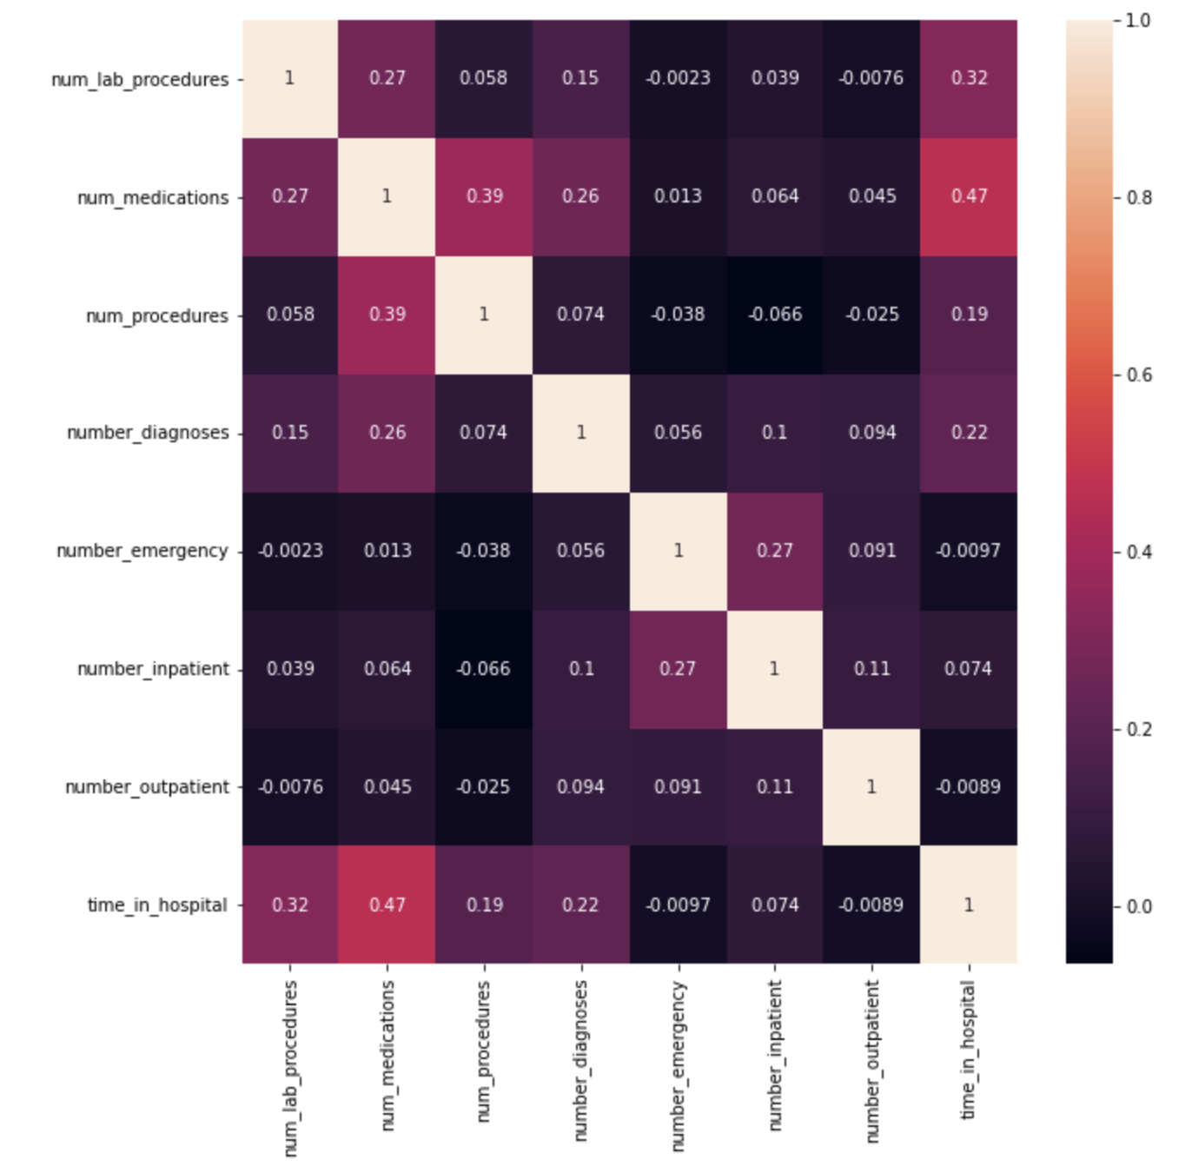
How are the variables correlated to one another?
Number of medications and time in hospital have a positive correlation of 0.47
Number of medications and number of procedures have a positive correlation of 0.39
Number of lab procedures and time in hospital have a positive correlation of 0.32

Slide 11
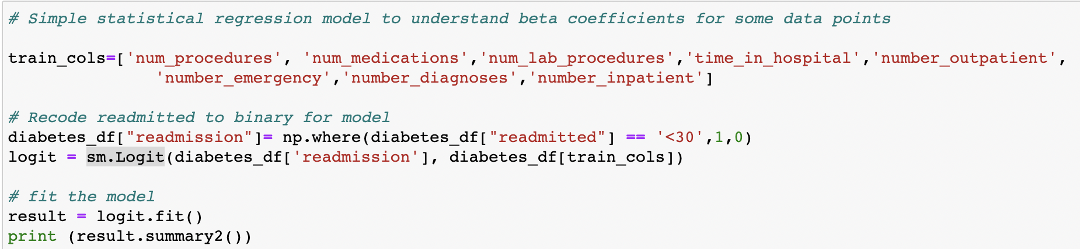
What can a logistic regression statistical model reveal?
Recoded readmission to be a binary variable
1 = <30 days readmission
0 = no readmission or >30 days readmission
Used the same measurements earlier that we explored correlational relationships between
Fit logistic regression model using statsmodels API in Python

Slide 12
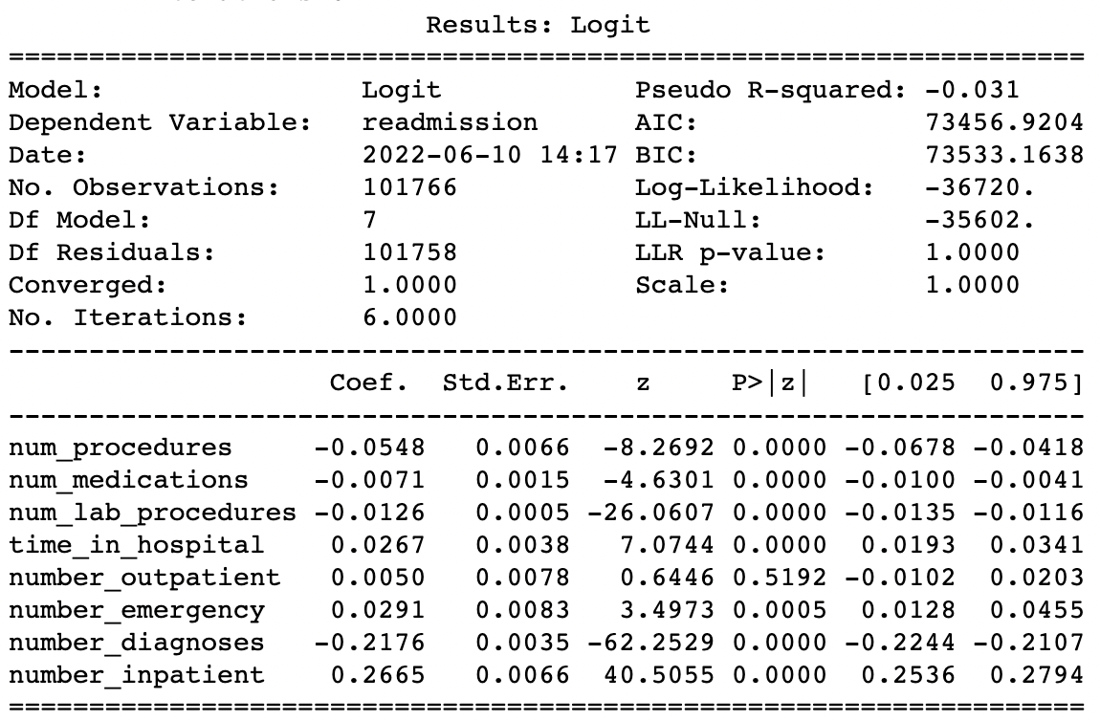
Model Interpretation
Based on a p-value of 0.05 being statistically significant…
number of procedures, number of medications, number of lab procedures, time in hospital, number of outpatient and number of emergency visits are significant predictors for readmission
Some interesting relationships…
number of procedures and number of medications are inversely related to readmission

Slide 13
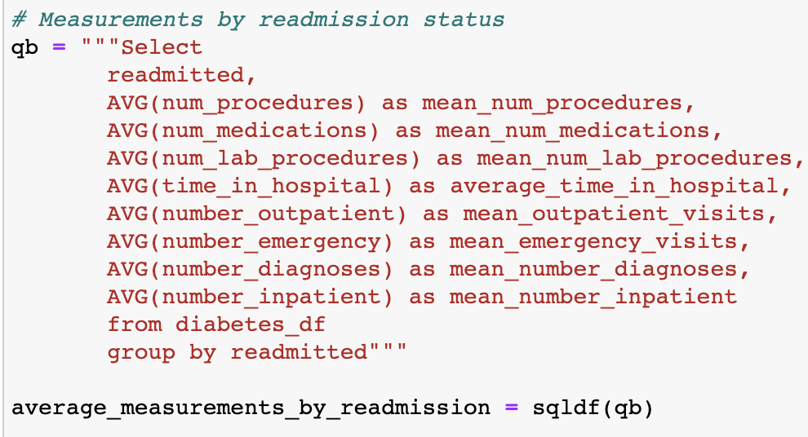
Compare measurements by readmission status

Slide 14
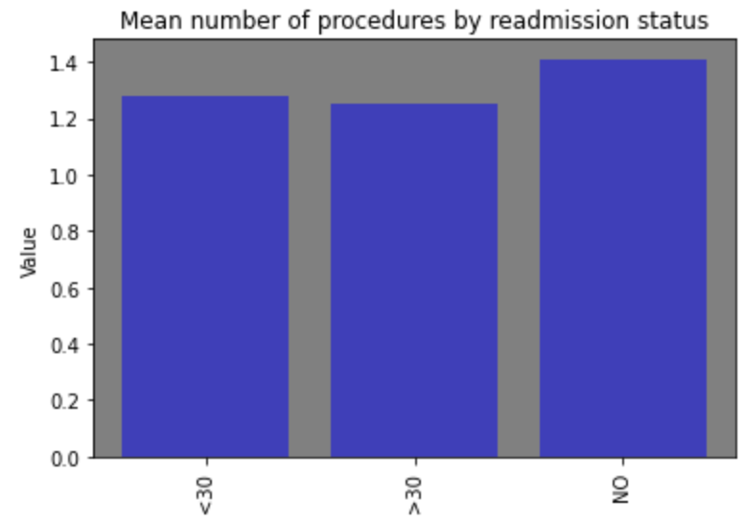
Mean Number of Procedures by Readmission Status
People who have the highest number of procedures were often not readmitted, which the logistic regression model also supported (Beta coefficient of -0.0548)

Slide 15
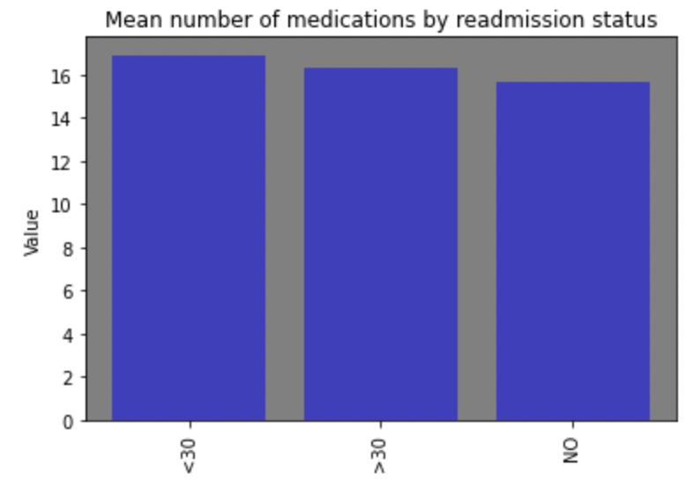
Mean Number of Medications by Readmission Status
People who were readmitted within 30 days had the highest number of medications (~>16)

Slide 16
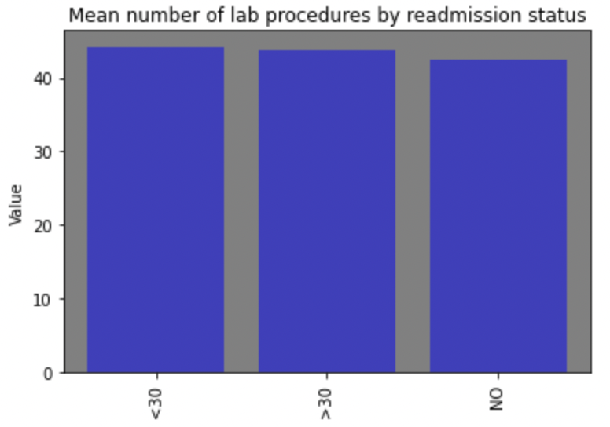
Mean Number of Lab Procedures by Readmission Status
People who were readmitted within 30 days had the highest number of lab procedures (~45)

Slide 17
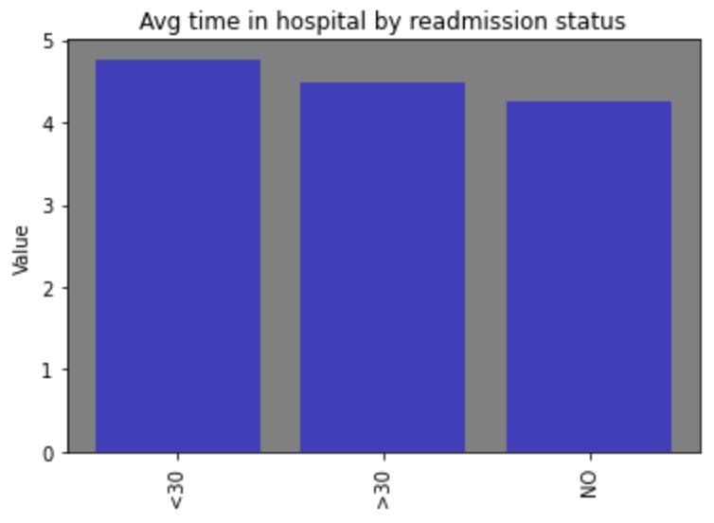
Mean Number of Time in Hospital by Readmission Status
People who were readmitted within 30 days had the highest amount of time spent in the hospital which the earlier model agreed with (beta coefficient = 0.0267)

Slide 18
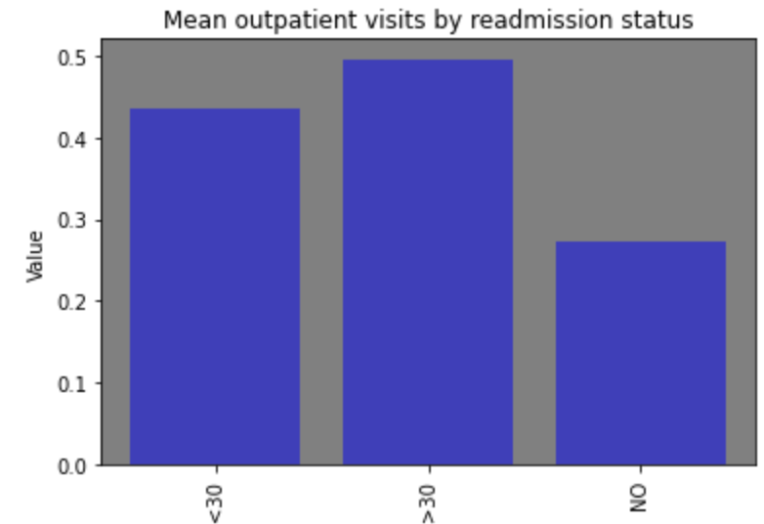
Mean Number of Outpatient Visits by Readmission Status
Patients who were readmitted after 30 days had the highest number of outpatient visits compared to patients readmitted within 30 days

Slide 19
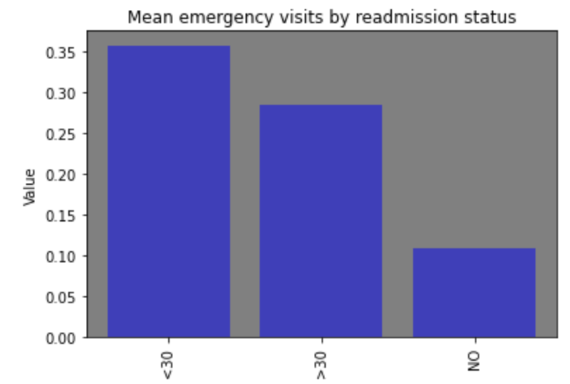
Mean Number of Emergency Visits by Readmission Status
People who were readmitted within 30 days had the highest number of emergency visits

Slide 20
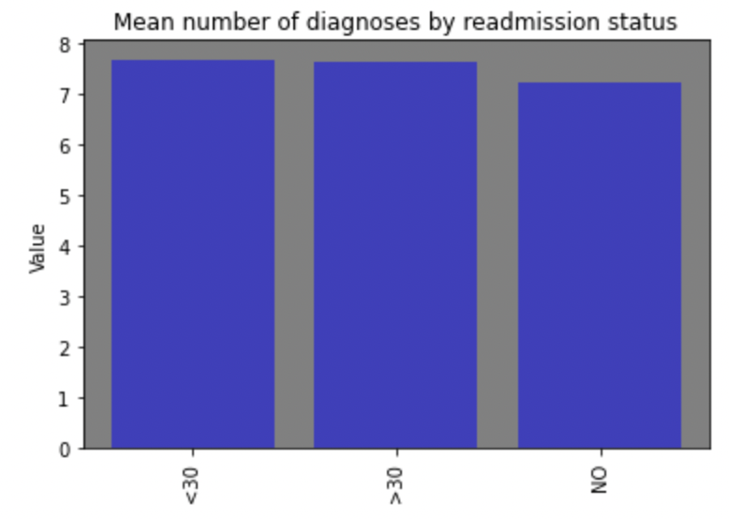
Mean Number of Diagnoses by Readmission Status
People who were readmitted within 30 days had a slightly higher number of diagnoses

Slide 21
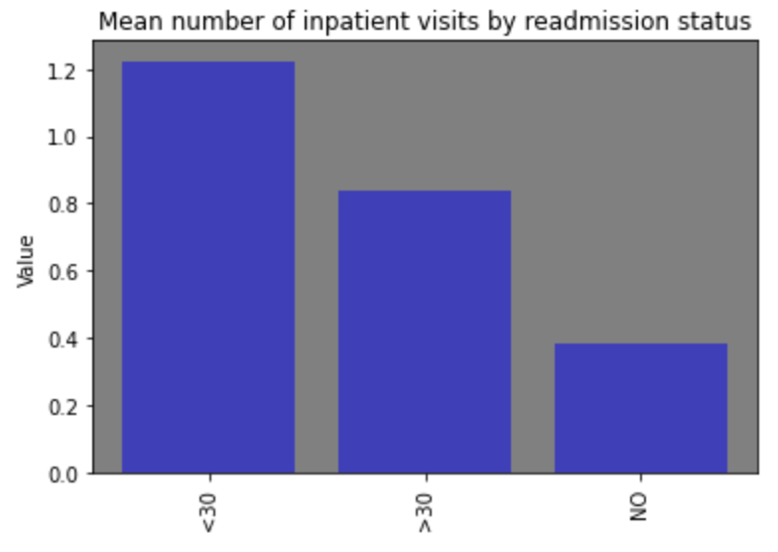
Mean Number of Inpatient Visits by Readmission Status
People who were readmitted within 30 days had the highest number of inpatient visits

Slide 22
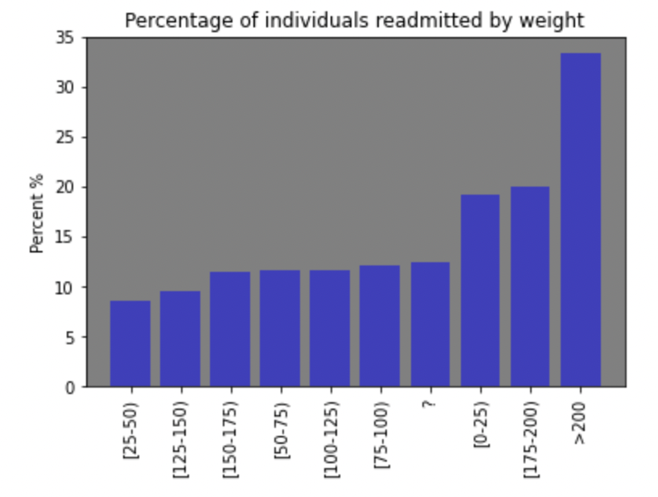
How is Weight Related to Readmission Status?
Hypothesis: Overweight patients have a higher likelihood of being readmitted within 30 days.

Slide 23
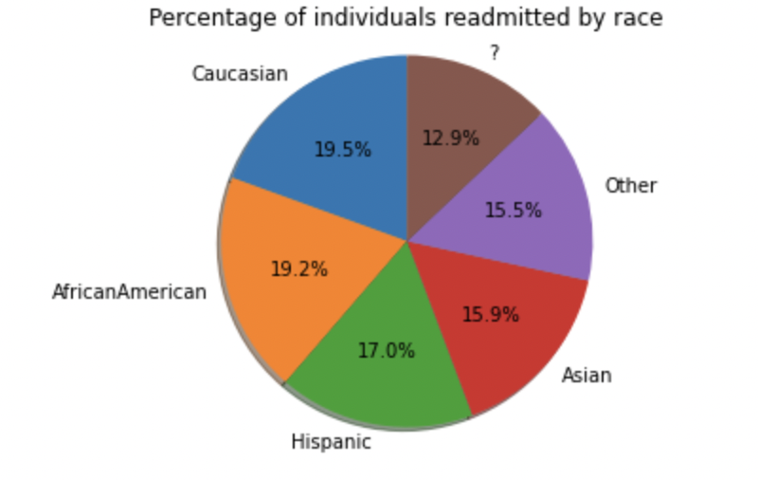
How is Race Related to Readmission Status?
Out of all patients, Caucasian patients accounted for the most readmission visits within 30 days (19.5%) followed by African American patients (19.2%)

Slide 24
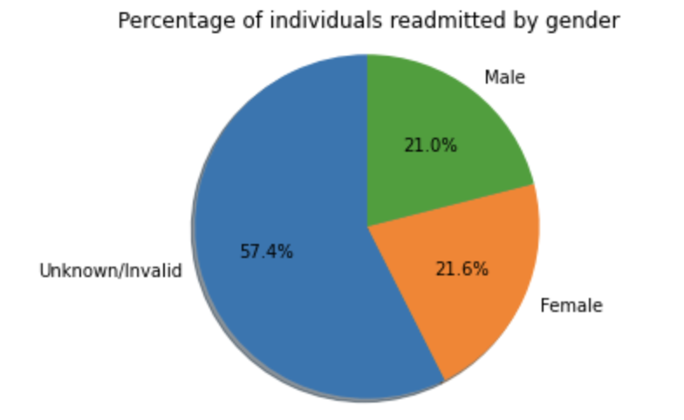
How is Gender Related to Readmission Status?
Out of all patients admitted, majority were of unknown gender (57.4%) followed by a roughly equal distribution of male and female gender

Slide 25
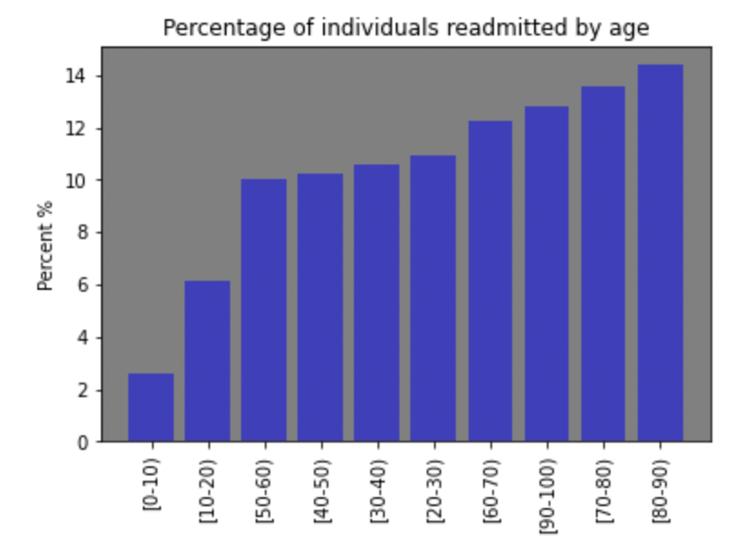
How is Age Related to Readmission Status?
Hypothesis: Older patients have a higher likelihood of being readmitted within 30 days.
Data shows that readmission rates increase with age, with the highest readmission percentages being for patients 80-90 years old.

Slide 26
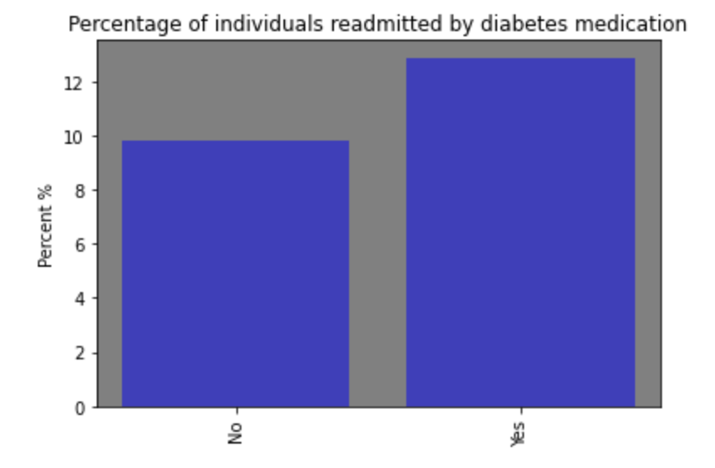
How is Diabetes Medication Related to Readmission Status?
Hypothesis: Patients who take more medications are less likely to be readmitted within 30 days.
Data shows the opposite → highest readmission visits within 30 days were for patients who did take medications

Slide 27
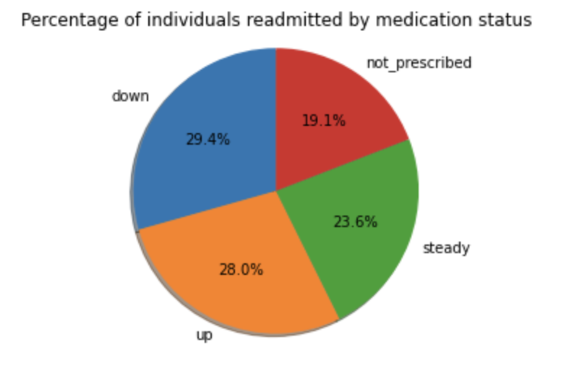
How is Change in Medication Related to Readmission Status?
Data shows that most patients who were readmitted within 30 days had their medications go down (29.4%), followed by patients who had their medications go up (28.0%)

Slide 28
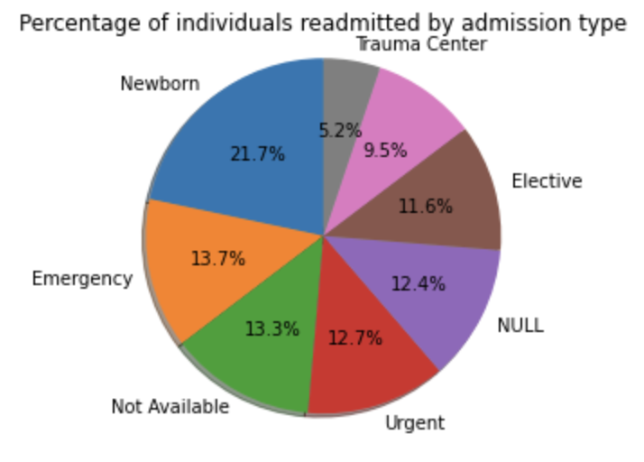
How is Admission Type Related to Readmission Status?
Newborn & emergency admission types had the highest readmission visits within 30 days

Slide 29
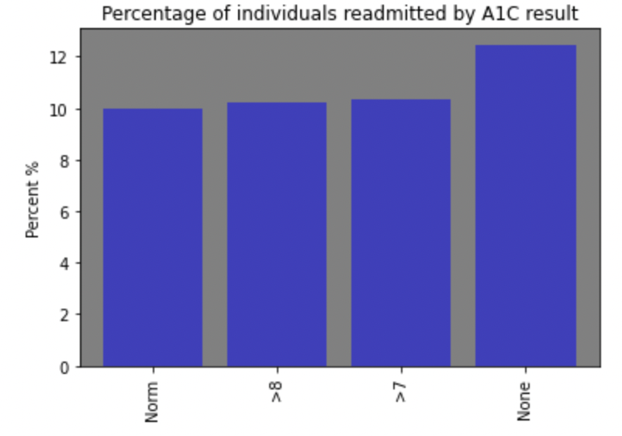
How Are A1C Results Related to Readmission Status?
Patients with normal A1C results had the lowest percentage of readmission visits within 30 days

Slide 30
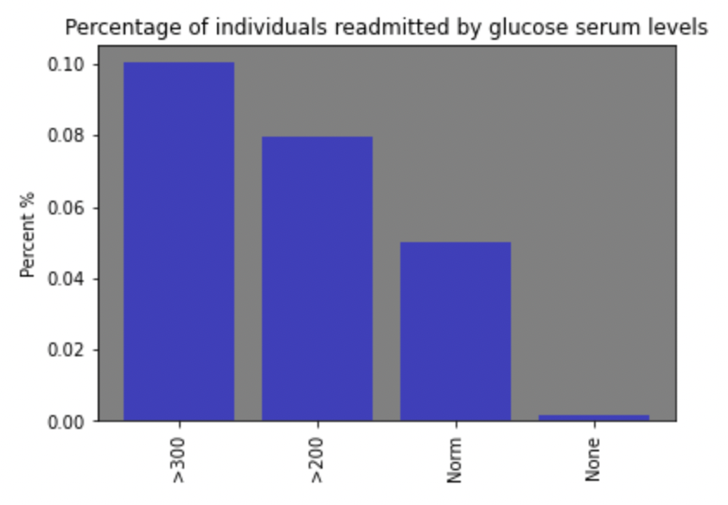
How Are Glucose Levels Related to Readmission Status?
Patients with glucose levels > 300 mg/dL had significantly higher readmission percentages compared to those with normal glucose levels

Slide 31
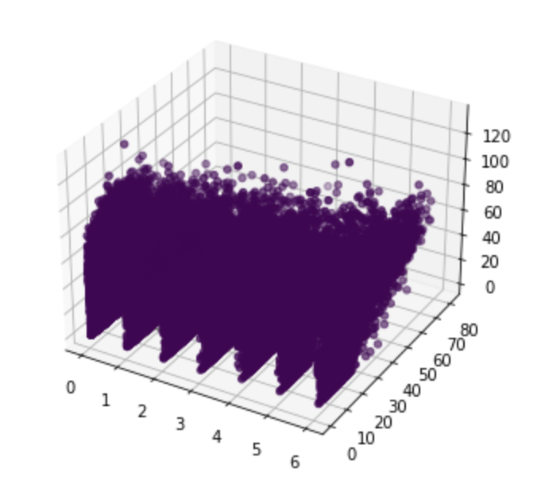
Are There Clusters of People Similar to Each Other?
Hard to tell with so many data points but more work would need to be done to understand if there are different clusters and what data points distinguish them

Slide 32
Conclusion
Readmission status within 30 days indicates that something went wrong or was missed in the patient’s first visit
Several factors correlate to higher readmission rates within 30 days such as…
Taking medication
Change in medications
Admission type (newborn and emergency visits)
Larger weight (>200)
Higher age (80-90 years)
Race (Caucasians and African Americans)
Elevated glucose levels (>300mg/dL)

